Slide 1
Enhancing the Validity and Cross-cultural Comparability of Measurement in Survey Research
Gary King (Harvard)
Christopher J. L. Murray (WHO)
Joshua A. Solomon (Harvard)
Ajay Tandon (WHO)

Slide 2
Purpose
How can we do survey research if different respondents (perhaps from different cultures, countries, or ethnic groups) understand questions in completely different ways, or if investigators mean one thing and respondents think they mean something else?
How can we develop accurate measures of complicated concepts which we can define only by example ("you know it when you see it"), and when attempts to produce more concrete questions tend to be more concrete but no more valid?
Possible solution: anchoring vignettes – (usually brief) descriptions of hypothetical people or situations that survey researchers can use to correct otherwise interpersonally incomparable survey responses

Slide 3
Dealing with DIF
Most widely used modern terminology for interpersonal incomparability is differential item functioning (DIF)
Methods of detecting or conquering DIF usually centers on the identification of common anchors that can be used to attach the answers of different individuals to the same standard scale

Slide 4
Survey Instrumentation: Anchoring Vignettes
Procedure for measuring sophisticated concepts with surveys is to gather a large number of examples and design a concrete question that covers as many of the examples as possible
The idea is to use the examples themselves in survey questions to estimate each person’s unique DIF and to correct for it
Ex: Provide anchoring vignettes of 5 hypothetical people (Alison, Imelda, Jane, Toshiro, and Moses) about political efficacy, which are all ordered from most efficacy (Alison) to least efficacy (Moses)
Question is read to each respondent for each vignette as well as self-assessment
How much say [does ‘name’/do you] have in getting the government to address issues that interest [him/her/you]?
Respondents are given the same set of ordinal response categories: 1) No say at all, (2) Little say, (3) Some say, (4) A lot of say, (5) Unlimited say

Slide 5
Measurement Assumptions
response consistency – each individual uses the response categories for a particular survey question in the same way when providing a self-assessment as when assessing each of the hypothetical people in the vignettes
the type of DIF may vary across respondents, and also for a single respondent across survey questions but not within the self-assessment and vignette questions answered by any one respondent about a single survey question
vignette equivalence – the level of the variable represented in any one vignette is perceived by all respondents in the same way and on the same unidimensional scale, apart from random measurement error

Slide 6
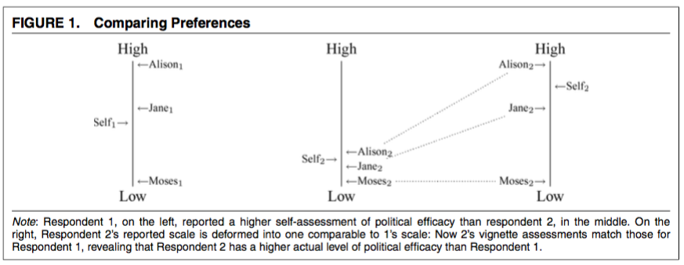
A Simple Non-Parametric Approach

Slide 7
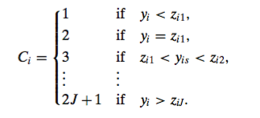
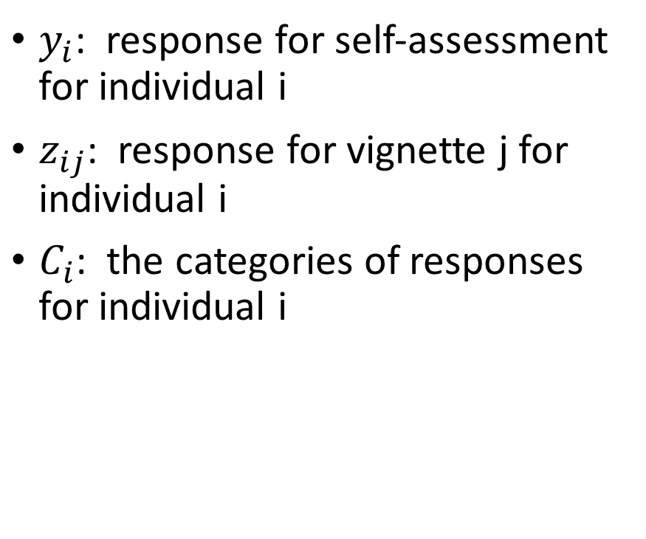
Non-Parametric Approach
$y_{i}$: response for self-assessment for individual i
$z_{ij}$: response for vignette j for individual i
$C_{i}$: the categories of responses for individual i

Slide 8
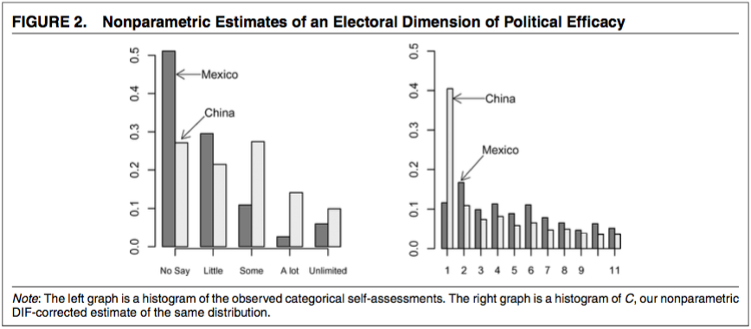
Non-Parametric Approach: Political Efficacy (Mexico vs. China)

Slide 9
A Parametric Approach: Modeling Thresholds
Model with a normal error term
Let thresholds vary over individuals as a function of measured explanatory variables
Generalization of the commonly used ordered probit model, where we model DIF via threshold variation, with the vignettes providing the key identifying information

Slide 10
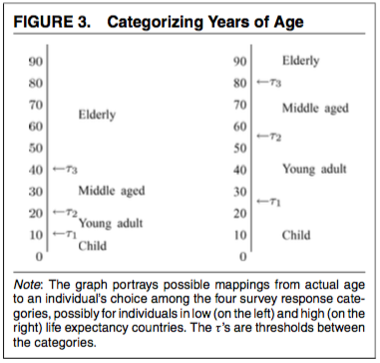
Age
Ex: Age: we can make inferences if the survey question only asked whether respondents described themselves as (A) elderly, (B) middle-aged, (C) a young adult, or (D) a child.
Age scale is broken at the threshold values τ1, τ2, and τ3, but the two individuals have different values of these quantities
Without knowing the threshold differences, we could easily get the age rankings of the countries wrong

Slide 11


The Model
Self-Assessment Component
Vignette Component

Slide 12
Model Interpretations
β (the effect of X ) and γ (the effect of V)
If variables omitted from and correlated with X have an effect on μ, we could have omitted variable bias just as in linear regression
The explanatory variables V will predict threshold variation in the measurement model (Eqs. [5] and [8])
Under our parametric model, researchers can test to a degree for vignette equivalence by checking whether the θ values are ordered as expected

Slide 13
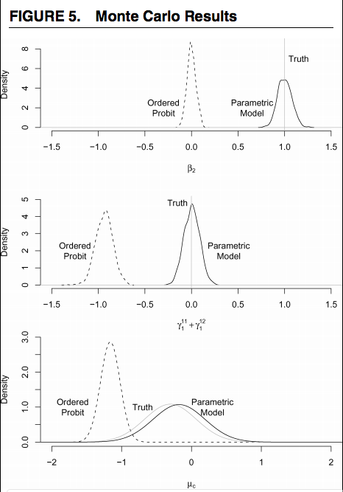
Monte Carlo Evidence
Ordered probit’s inability to correct for DIF makes it miss most of the true density, while estimates from our model are on target

Slide 14
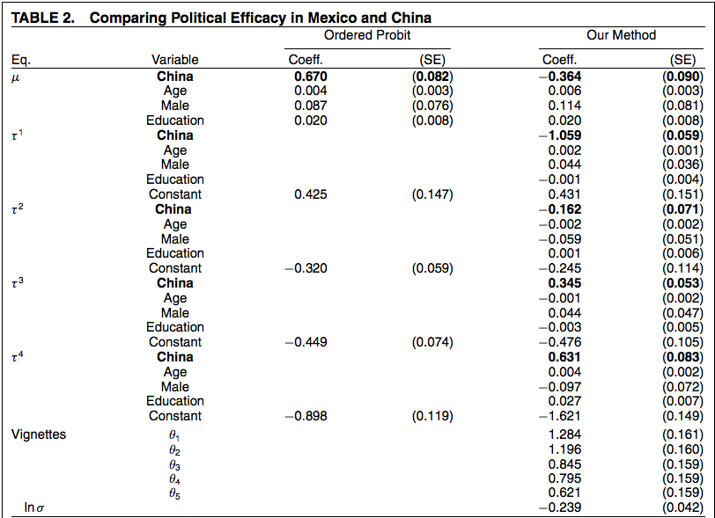
Empirical Evidence: Political Efficacy

Slide 15
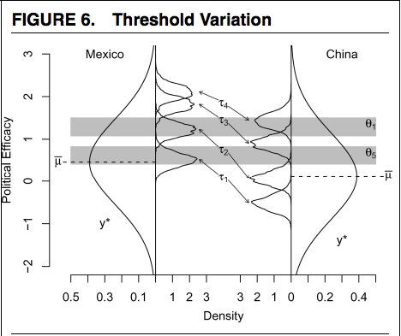
Empirical Evidence: Political Efficacy
Chinese respondents have lower actual levels of political efficacy than the Mexicans
But the Chinese also have even lower standards for what qualifies as any particular level of “say in government”

Slide 16
Conclusion and Comments
Current problems: try to measure complicated concepts, such as political freedom and efficacy, that researchers define best with reference to examples; and what to do when respondents interpret identical questions in different ways
Solution: measure incomparability via respondents’ assessments, on the same scale as the self-assessments to be corrected, of hypothetical individuals described in short vignettes
Can show how response incomparability can drastically mislead survey researchers and how our approach can alleviate this problem
Great potential to reduce bias, increase efficiency, and make measurements more interpersonally comparable than existing methods
Issue with response consistency: violated if respondents who feel inferior to hypothetical individuals set a higher threshold for what counts as their having “a lot of say” in government than they set for the people described in the vignettes
Issue with vignette equivalence: Nonparametric method heavily relies on this assumption but what if different people order vignettes differently? This will violate this assumption but in the parametric method, we can test for equivalence

